Slide 1
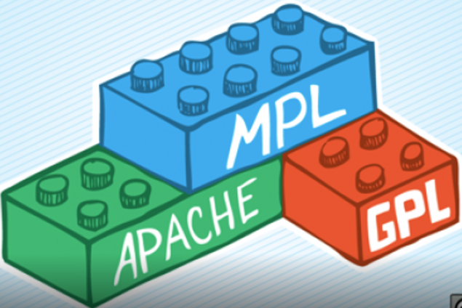



06 – Intellectual Property and Software Licensing
COMP 190 – Dickinson College
Fall 2022
Images from: https://opensource.org/, https://www.fsf.org/
https://fossbytes.com/open-sources-license-type/
Notes:
Starting a new section that will begin to look at OSS development.
- Some concepts
- Some tools and techniques
- largely the same as those adopted in close source / proprietary software
- version control / git / GitHub
- Containers and docker
What was FOSS?
- Free and Open Source Software
What did that mean?
- Four Freedoms (https://www.gnu.org/philosophy/free-sw.en.html#four-freedoms)
- Collect a list of these on the board.
- Run and use the program how you wish
- Study and change the program
- Note – this requires the source be open.
- Redistribute copies
- Redistribute copies with your modifications

Slide 2
Intellectual Property Protections
Software, like other inventions and creative works, is the Intellectual Property (IP) of those that created it, or the companies they work for (i.e. work for hire).
There are four main categories of legal protection for Intellectual Property:
Trademarks
Patents
Copyrights
Design Rights
Notes:
If you create IP then you have the legal right to control how it is used.
Or if you create IP for an employer they will typically, due to your employment contract, have that right.
- This is known as a work for hire.
There are four main categories of legal protection that can be used to control how IP is used.
- Which one applies depends upon what you are protecting.
- We’ll deal with that in a moment.
- These are legal protections and thus are governed by national and international laws
- Extremely complex
- Will differ by country
- We’ll be trying to understand the basic ideas, see how they apply and look at some limited details.
- Legal teams deal with the details when it really matters.
We’ll be looking primarily at the first 3 now.
You’ll see a little bit about the 4th in the Activities.

Slide 3
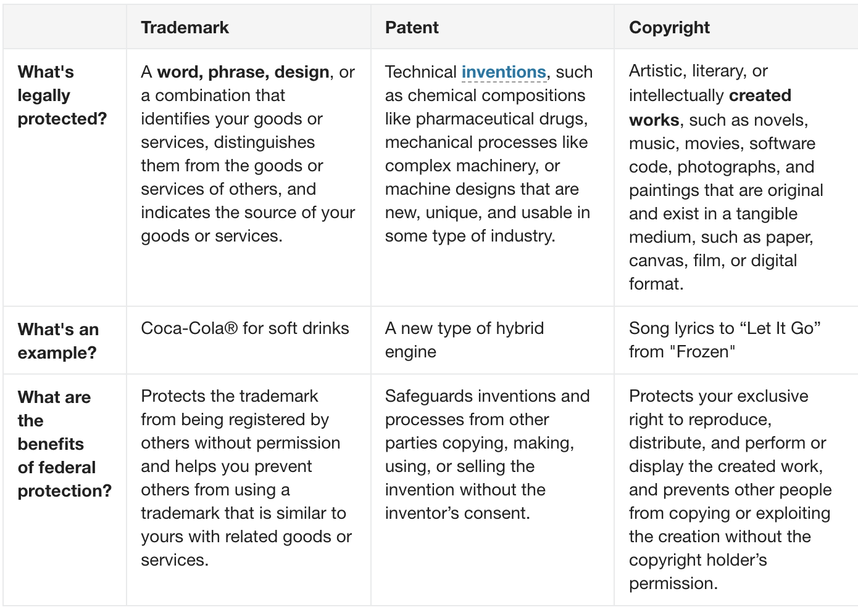
Activity
Using the table at:
https://www.uspto.gov/trademarks/basics/trademark-patent-copyright
For each of:
Trademark
Patent
Copyright
Identify:
keywords that describe what is protected.
keywords that describe what is required to receive that protection.
Notes:
You are likely familiar with these terms.
- But generally there is a lot of confusion around
- what they are
- how they are used
Using the table which gives more precise – but still non-legal – descriptions
In small groups:
- Everyone in group of 3 or 4 neighbors.
- Maybe 5 minutes
Report out.
- Report out and collect lists on the board under headings for each type of protection.
- discuss any disagreements among the groups.
For required:
- Trademark – must be registered with a governing body (e.g. US PTO)
- Patent – must be filed and approved by a governing body (e.g. US PTO)
- Copyright – AUTOMATIC... The moment it exists in a “tangible medium”
- That is, the moment you write it down, draw it, paint it, record it, it is copyrighted.
- THIS IS AN IMPORTANT POINT!
- Can also file an official copyright governing body
- Can help make it easier to stop others who infringe on your copyright by using it without your permission.
- But officially does not give you any more rights.

Slide 4
Activity
Using the last activity and the table at:
https://www.uspto.gov/trademarks/basics/trademark-patent-copyright
Discuss and come to a consensus of the type of protection that is most likely to apply to each of the following:
This presentation
The name Microsoft
The Java String class
The sound an iMac makes at startup
The Linux kernel
The Microsoft Windows operating system
Google’s PageRank algorithm
The term PageRank
Google’s implementation of PageRank
Notes:
Using the table which gives more precise – but still non-legal – descriptions
In your small groups
- Discuss the items listed
- come to a consensus on the type of IP protection that would likely apply to each.
- Likely take 10 minutes
Report out.
- discuss any disagreements among the groups.
- the last set of 3 is a little tricky…
- It’s patent, trademark and copyright
- It is an expression of a process.
- branding that distinguishes it.
- Exists in a tangible medium.
Notes:
- The iconic startup sound of Apple's Mac computers is now trademarked in the United States
- https://www.cnet.com/news/apple-wins-u-s-trademark-for-mac-boot-chime/
- The word pageRank is a trademark of Google, and the PageRank process has been patented (U.S. Patent 6,285,999).
- Wikipedia
- The original PageRank patent, developed and owned by Google, expired on January 9th, 2019.
- Google holds an updated PageRank patent titled “Producing a ranking for pages using distances in a web-linked graph.”
- https://blogs.cornell.edu/info2040/2019/10/28/googles-pagerank-patent-has-just-expired-heres-what-happens-now/

Slide 5
Software as Intellectual Property
For software as intellectual property it is possible that multiple protections apply:
It is a “creative work” that exists “in a tangible medium.”
That program is copyrighted
It can “express a process” that is “new, unique”, and “usable in some type of industry.”
That process can be patented.
It provides “goods or services” and the name “distinguishes them from others.”
That name can be trademarked.
Notes:
This is a concrete recap of some of what should have come from discussion on prior slide.
- So may be quick.
All software, like every creative work, is immediately and automatically copyrighted.
- Including any program that you write.
- So not only is copying someone else's code often cheating, its actually illegal (in the US at least).
If the software expresses a novel process with commercial value, then that process is patentable.
https://arapackelaw.com/patents/softwaremobile-apps/recent-software-patent-examples/
- Googles pageRank algorithm for ranking search results
- AirBnB – automated determination of booking availability
- CoinBase – instant exchange of bitcoin payments
- Facebook – dynamic mask application
Software provides services and thus can be given a name and and that name can be trademarked to distinguish it.
- Microsoft Word, Windows, PowerPoint, etc
- Adobe Acrobat
- Safari

Slide 6
Copyright - Key Points
Protects:
Creative works
Requires:
Work must be original
Must exist in a tangible medium
Copyright applies immediately upon the work being fixed in a tangible medium.
Can but does not have to be registered
Notes:
Copyright is the basis for the majority of software licensing
- Particularly in FOSS
- Though patents do play some role.
- So this is here just to solidify what we know.
The point about when it applies is important.
- If you create something you own the copyright immediately.
- If you create it for work, then the company typically owns it immediately.
Registering does not change your rights as the copyright owner.
- Allows you to formally establish that you were the creator
- Thus, it make it easier to legally defend your copyright against infringement.

Slide 7
Software and Licensing
Software licenses are legal documents used by copyright holders to grant or restrict your permission (rights) to copy, distribute, modify and redistribute the software.
Proprietary Software Licenses
Commercial development
Restrictive
Free and Open Source Software (FOSS) Licenses
Community development
Permissive
Notes:
Two broad categories of licenses.
Proprietary licenses
- Usually employed by companies who earn money from the sale of the software
- These licenses are typically restrictive and use the copyright ownership to:
- keep the code secret
- prohibiting copying, sharing, modifying, redistributing the software
- protect the company’s ability to make a profit from the sale of the software.
FOSS licenses
- Employed to ensure the software is available to benefit everyone.
- The value here is not commercial.
- Instead, the value is:
- its availability for all to use and improve
- the expanded community working on its development
- the expanded community of users
- These licenses are generally permissive and use the copyright ownership to:
- Grant others the rights to “the 4 freedoms”

Slide 8
FOSS Licenses
A license makes software Free and Open Source by granting specific permissions for how others may use the copyrighted work and by specifying what is required of those users in order to receive the permissions.
Permissive Licenses
Permissions: “Do Anything” / “Anything Goes”
Requirements: Typically just attribution
Copyleft Licenses
Permissions: Four freedoms:
Requirements: “Share-a-like” / ”Reciprocal”
”Contagious” / “Viral”
Notes:
Two extremes of FOSS licenses
- There is now a spectrum of licenses in between these two extremes
- Permissive
- Grant the user the right to do pretty much anything they want with the IP.
- With minimum if any requirements of the user.
- Also called “do anything” or “anything goes” licenses.
- Copyleft (a play on copyright)
- Usually grant the 4 freedoms.
- Require that in order to receive those permissions what you produce must also have a copyleft license.
- Also called …
- Share-a-like or reciprocal - if you want a positive connotation
- Contagious or Viral - if you want a negative connotation

Slide 9
The MIT License (MIT)
Copyright (c) <year> <copyright holders>
Permission is hereby granted, free of charge, to any person obtaining a copy of this software and associated documentation files (the "Software"), to deal in the Software without restriction, including without limitation the rights to use, copy, modify, merge, publish, distribute, sublicense, and/or sell copies of the Software, and to permit persons to whom the Software is furnished to do so, subject to the following conditions:
The above copyright notice and this permission notice shall be included in all copies or substantial portions of the Software.
THE SOFTWARE IS PROVIDED "AS IS", WITHOUT WARRANTY OF ANY KIND, EXPRESS OR IMPLIED, INCLUDING BUT NOT LIMITED TO THE WARRANTIES OF MERCHANTABILITY, FITNESS FOR A PARTICULAR PURPOSE AND NONINFRINGEMENT. IN NO EVENT SHALL THE AUTHORS OR COPYRIGHT HOLDERS BE LIABLE FOR ANY CLAIM, DAMAGES OR OTHER LIABILITY, WHETHER IN AN ACTION OF CONTRACT, TORT OR OTHERWISE, ARISING FROM, OUT OF OR IN CONNECTION WITH THE SOFTWARE OR THE USE OR OTHER DEALINGS IN THE SOFTWARE.
Notes:
Let’s look at an example of a license.
- Note: The small text disclaims liability
- Important , but less relevant to this conversation
ASK:
- What permissions does this license grant?
- Are any of those surprising? What does that mean?
- What does this license require to receive those permissions?
- Just include the license with the software that was copied or modified.
- Is this license permissive or copyleft?
- Why do you think that?
- Important Notes:
- This license allows but does not require that you permit persons to whom you furnish the software do the same.
- You can place any restrictions you like on your version – i.e. sublicence it.
- But note that anyone can still do what they want with the original (i.e. get it from where you got it).

Slide 10
GNU GENERAL PUBLIC LICENSE Version 3, 29 June 2007
Copyright (C) 2007 Free Software Foundation, Inc
…
5. Conveying Modified Source Versions. You may convey a work based on the Program, or the modifications to produce it from the Program, in the form of source code under the terms of section 4, provided that you also meet all of these conditions:
a) The work must carry prominent notices stating that you modified it, and giving a relevant date.
b) The work must carry prominent notices stating that it is released under this License and any conditions added under section 7. This requirement modifies the requirement in section 4 to “keep intact all notices”.
c) You must license the entire work, as a whole, under this License to anyone who comes into possession of a copy.
…
Notes:
Let’s look at another example of a license.
- Note: This is just a small part of this particular license.
ASK: What permissions does this section of the license grant?
- what does it mean?
- you may convey a work based on the program…
- you can redistribute the program with modifications…
- Earlier sections in the license grant the other permissions.
ASK: What is required to receive that permission?
- Must indicate that you’ve changed the program and when.
- Must clearly indicate that it is released under this licensee.
- THE BIG ONE!!!
- “the entire work, as a whole,” must be licensed in the same way to anyone.
ASK: Is this license permissive or copyleft?
- Why do you think that?

Slide 11
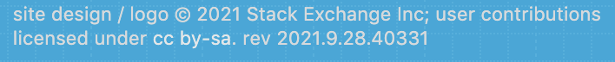
This Can Get Complicated…
Consider code snippets posted to Stack Overflow…
https://meta.stackexchange.com/questions/12527/do-i-have-to-worry-about-copyright-issues-for-code-posted-on-stack-overflow
Notes:
Stack Overflow:
- A site where a community of users post and answer technical questions for each other.
- If you search for an error message or a question about how to do something programming related, you will likely get stack overflow hits.
- Extremely useful when used correctly.
- Has anyone ever used this site?
So what about the copyright of the content on Stack Overflow:
- We know that soon as someone writes a question, or an answer then they own the copyright to that.
But…
- If you look at the bottom of a Stack Overflow page you will see that:
- ”user contributions [are] licensed under cc by-sa”
- Updated on-line to 2022 and a new rev… .but still cc by-sa
Let’s see what that means…

Slide 12
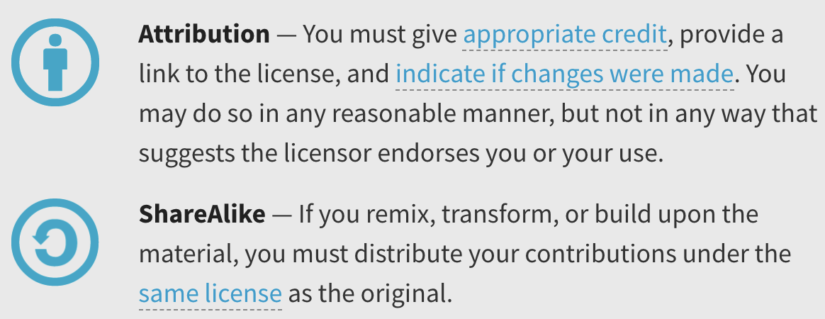

This Can Get Complicated…
Consider code snippets posted to Stack Overflow…
https://meta.stackexchange.com/questions/12527/do-i-have-to-worry-about-copyright-issues-for-code-posted-on-stack-overflow
Notes:
CC indicates a Creative Commons License
- A CC license like others grants permissions for the use of copyrighted material
- With requirements.
- by – is attribution - means you must give credit if you use it.
- sa - means you must share alike
So as soon as someone posts a question or an answer to Stack Overflow
- That content is licensed to the world under CC by-sa.
ASK: Is this a permissive or copy-left license?
- Copyleft
- NOTE: With CC you can generate the license you want.
- More in a second…
ASK: What implications or questions does a copyleft license raise here?
- Can you copy what you find and use it in your own code?
- What are the requirements for you to receive that permission?
ASK: What are the implications of that?
- See what they come up with
- what must you do if you copy it into a homework or lab solution?
- what happens if you are working for a company and copy it into a commercial program?
- You will explore this a little more in activities.
Interesting Side Note:
- Because of the existence of copyleft licenses…
- Commercial software companies go to great length to ensure that no copyleft code appears in their products.
- Clean room design – reverse engineer specs, legal review, separate team implements from specs
- Good for copyright but doesn’t work for patents (ASK: Why not?)
- Legal reviews of software
Another interesting side note (probably beyond the scope):
- CC BY SA 4.0 allows one way move from CC -> GPL3 but not the reverse.
- That is you put StackOverflow code into a GPL3 project, but you cannot go the other way.
https://www.fsf.org/blogs/licensing/creative-commons-by-sa-4-0-declared-one-way-compatible-with-gnu-gpl-version-3#:~:text=Creative%20Commons%20BY%2DSA%204.0,Working%20together%20for%20free%20software

Slide 13
What’s Next?
HW 06 – 1 Week
Back quizzes (Q2 – Q5)
Quiz 06
Revise and resubmits of HW 05 as desired/necessary.
1 Week from return date.
Prepare for the reading and discussion

Slide 14

Acknowledgments:
Slide Template From:
https://creativecommons.org/licenses/by/4.0/
Slide Content Licensed as:
https://creativecommons.org/licenses/by-nc/4.0/
Notes:
Might be a good time to point out this!
And the CC on the first slide too.
CC BY-NC
- Attribution, Non-Commercial
- But not copyleft.
Note CC BY-SA-NC on activities though.

